Slide 1

Biased Review Detection CMPE 255 - Group 13
Aayushi Gupta (01379958)
Anjali Deshmukh (013859196)
Sneha (013850174)
Vaibhav Gupta(013859417)

Slide 2

Reviews influence our Opinion
Nearly 95% of shoppers read online reviews before making a purchase.
Reviews are a powerful form of consumer engagement.

Slide 3
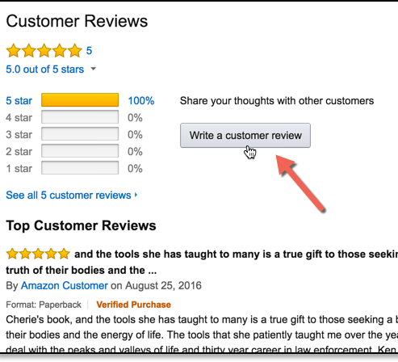
Why is this important?
Big businesses like Amazon earn millions of dollars based on the online selling platform where they give countless options to the customers.
Customers highly depend on the reviews given by previous customers to decide on buying that product.
Thus it is very important that these reviews are dependable.
Our dataset consists of around 20 thousand labelled customer reviews from Amazon for various products.

Slide 4

DataSet
Real customer reviews data set from Amazon.com
Source: Amazon (requested through student mail & follow-up)
Categorized as: Biased & Unbiased labelled Vectors.
Data Count: 21000
Biased: 10500; Unbiased: 10500
Fields (Count 10): DOC_ID, LABEL, RATING, VERIFIED_PURCHASE, PRODUCT_CATEGORY, PRODUCT_ID, PRODUCT_TITLE, REVIEW_TITLE, REVIEW_TEXT
Notes:
Consider talking about:
School and university
Project management
Civil and military construction and industry infrastructure
Computer software
State project

Slide 5



Feature set
Features considered for training the model
From DataSet:
Verified_Purchase
Review Text
Explored:
Review Nouns
Review Polarity
Review Word Count
Review Adjectives
Review Adverbs
Review Verbs
Review Length

Slide 6
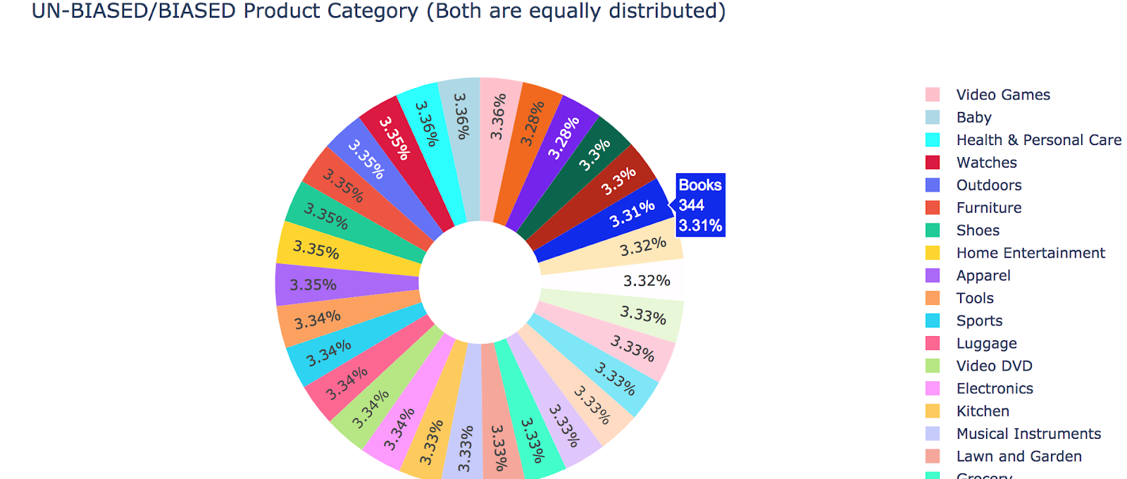
Product Category Distribution

Slide 7
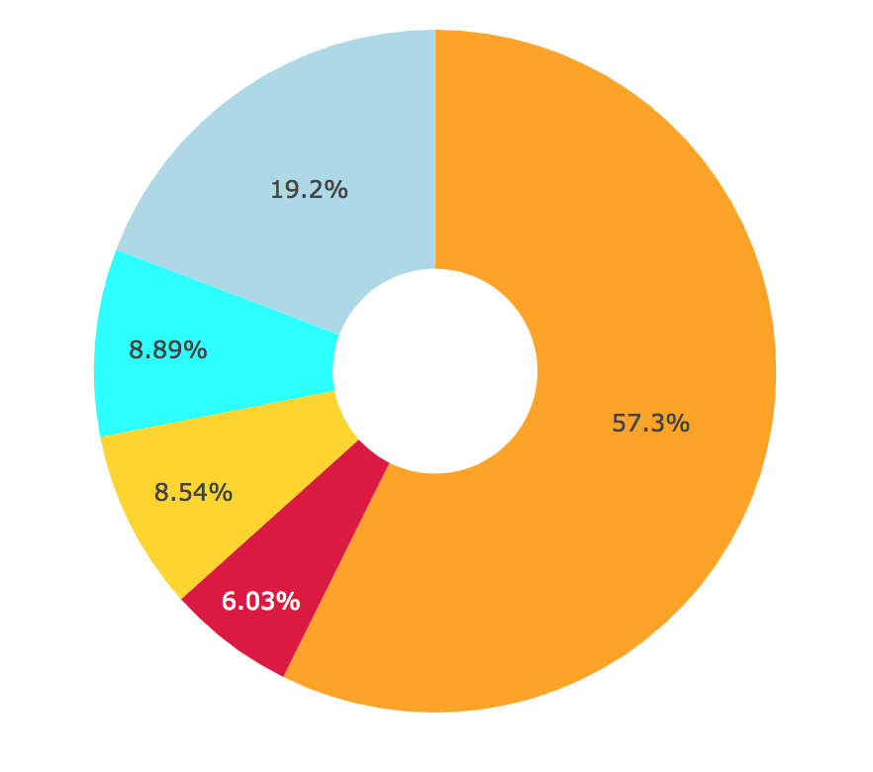
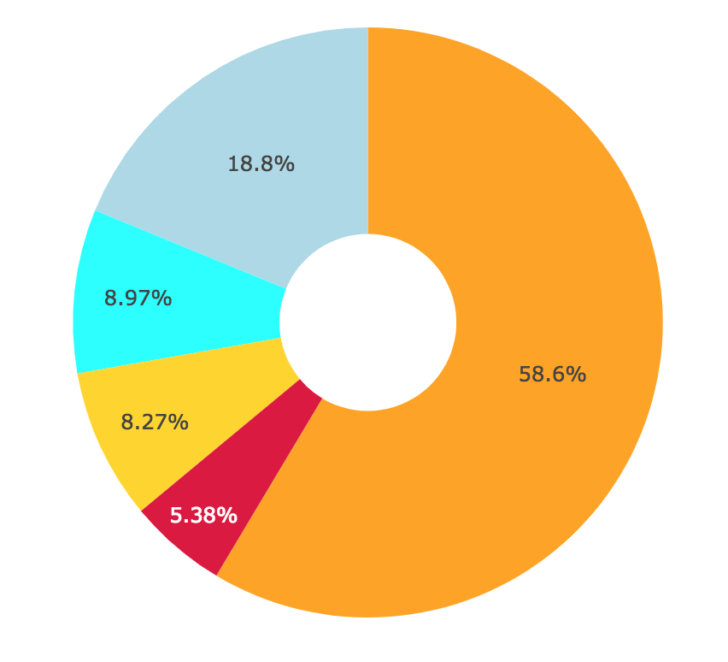
Ratings Distribution
BIASED
UNBIASED

Slide 8
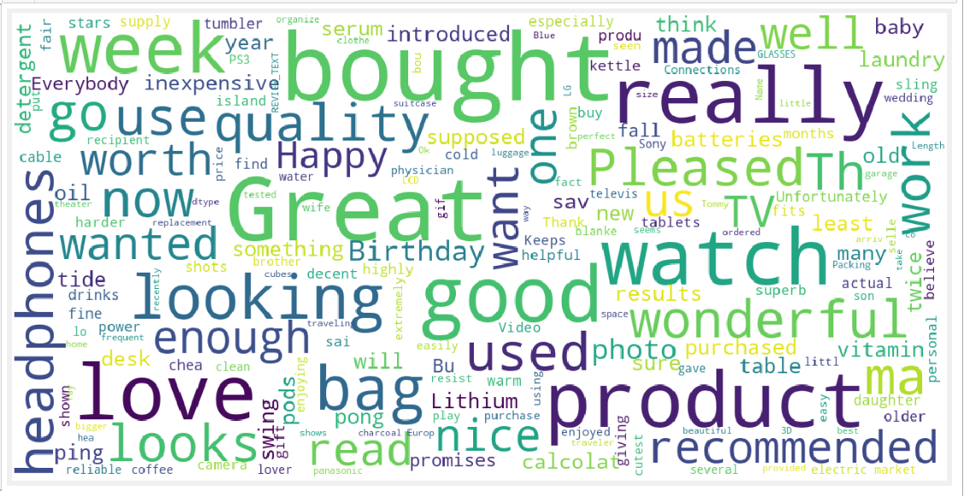
Word Frequency/Most used Words

Slide 9
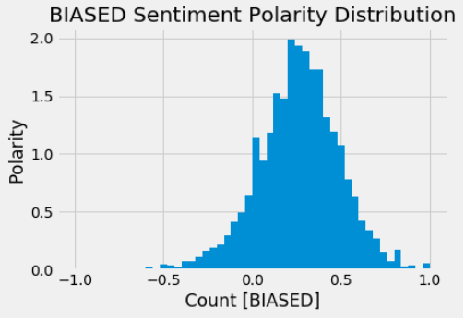
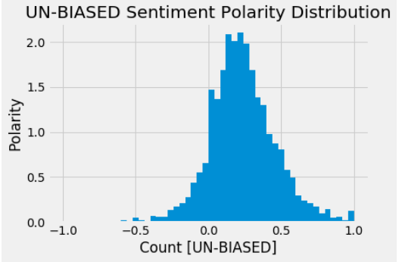
Polarity distribution for the biased and unbiased label sets:

Slide 10
Dimensionality Reduction
Removed the features DOC_ID, PRODUCT_CATEGORY, PRODUCT_ID as they played no significant role in the model training and prediction.
Performed feature aggregation - combined REVIEW_TEXT and REVIEW_TITLE and then used it as a single feature.
Implemented PCA on the newly created features

Slide 11
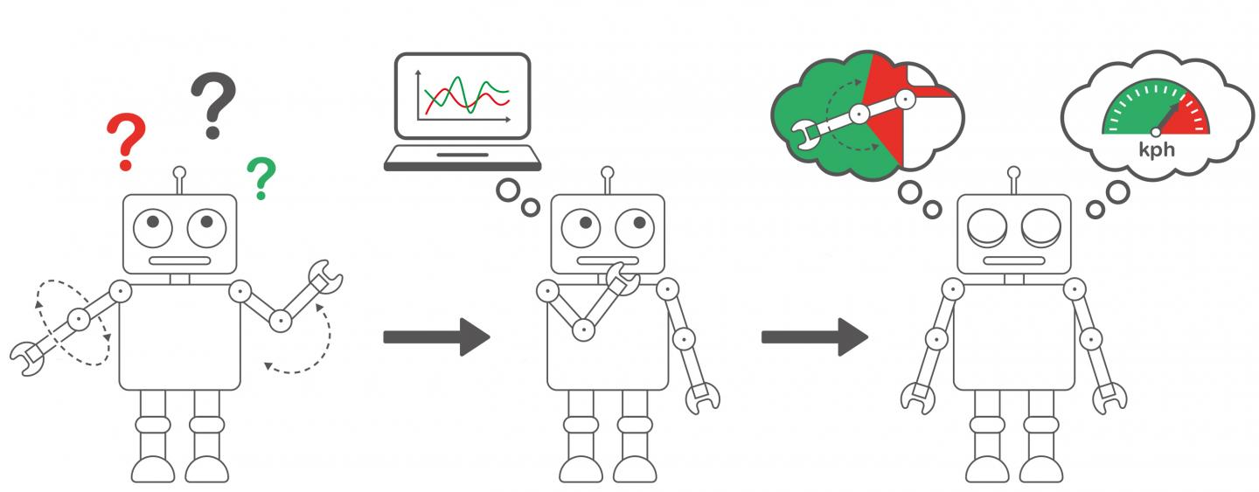
Machine learning algorithms used
Classification models:
Logistic Regression
SVM
Decision Tree
Logistic Regression with N-GRAMS
Ensemble methods:
Random Forest
Gradient Boosting
Extreme Gradient Boosting
Adaptive Boosting

Slide 12
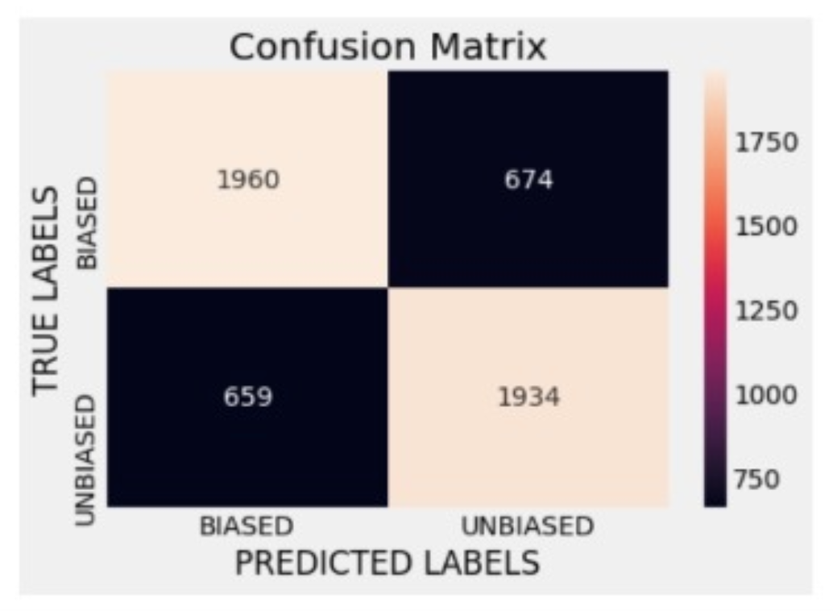
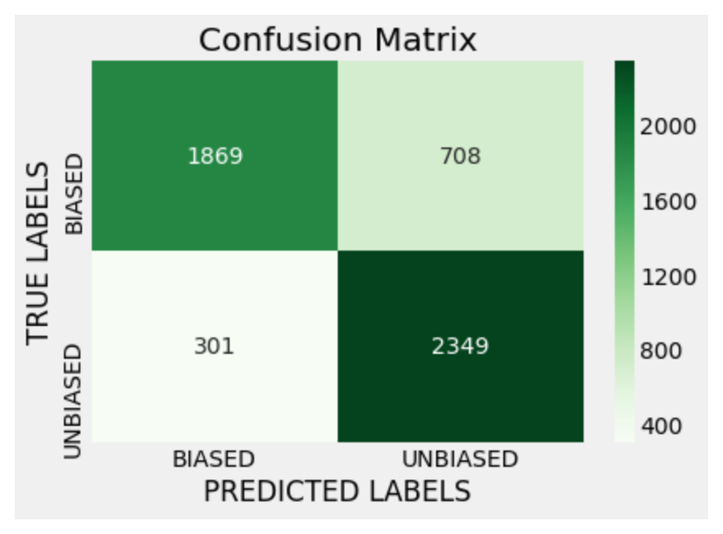
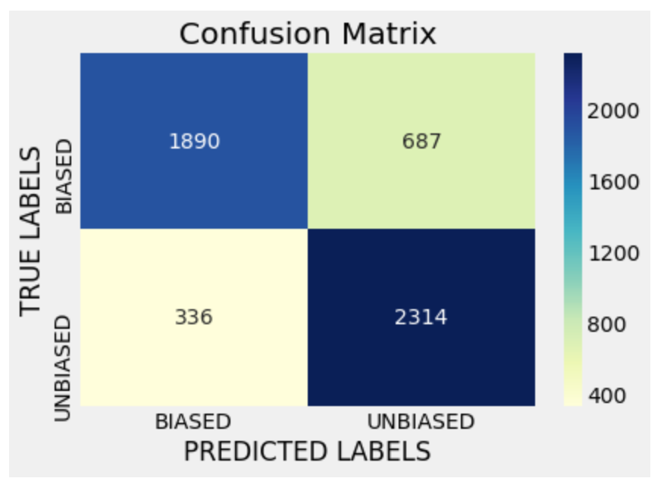
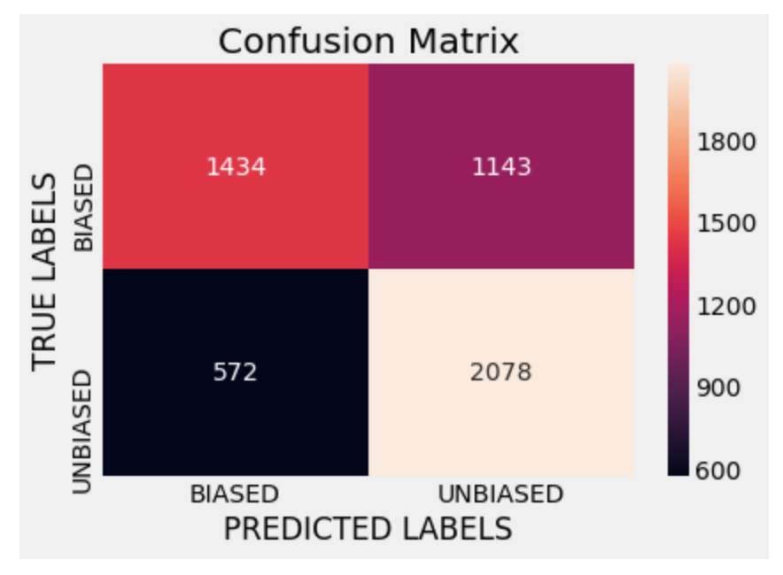
Decision Trees
Gradient boosting
SVM
Logistic Regression

Slide 13
Model Results
Model | Accuracy | Precision | Recall | F1 score
Logistic Regression | 80% | 0.85 | 0.73 | 0.79
Logistic Regression (with NGRAMS) | 65% | 0.67 | 0.66 | 0.67
Decision Tree | 81% | 0.86 | 0.73 | 0.79
SVM | 67% | 0.71 | 0.56 | 0.63
KNN | 68% | 0.69 | 0.65 | 0.67
Random Forest | 76% | 0.75 | 0.74 | 0.75
Gradient Boosting | 81% | 0.86 | 0.73 | 0.79
XGBoost | 81% | 0.86 | 0.73 | 0.79
AdaBoost | 80% | 0.85 | 0.73 | 0.79

Slide 14




Lessons Learnt:
Data exploration and preprocessing form the very important steps.
Quality of the dataset plays a vital role in building quality models. “Garbage in Garbage out policy” exists.
Text mining process is challenging-”especially if we have less number of features to rely on”.
Model accuracy can be improved with hyper-tuning parameters.

Slide 15

After a lot of data exploration, Feature engineering and trying out a number of machine learning algorithms, we achieved a maximum accuracy of 80.6% in identifying biased customer review.
Github Repo:
https://github.com/Anjali-Deshmukh/255_DataMining

Slide 16
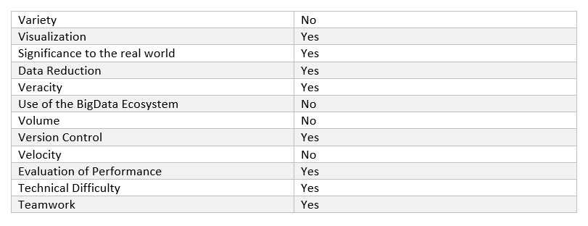
Rubrics

Slide 17
References
1. https://spiegel.medill.northwestern.edu/_pdf/Spiegel_Online%20Review_eBook_Jun2017_FINAL.pdf
2. Towards understanding and detecting fake reviews in app stores:
https://link.springer.com/article/10.1007/s10664-019-09706-9
3. Yelena Mejova. Sentiment Analysis: An Overview, https://www.academia.edu/291678/Sentiment_Analysis_An_Overview
4. C.J. Hutto, Dennis Folds, Scott Appling, “Computationally Detecting and Quantifying the Degree of Bias in Sentence-Level Text of News Stories”(HUSO 2015)
5. Nitin Jindal, Bing Liu, “Review Spam Detection” (WWW 2007 / Poster Paper)

